Slide 1
Object Detection using Convolution Neural Network
Faster RCNN

Slide 2

Follow up Contents
Faster RCNN
Summary and Drawback of Fast RCNN
Approach to solve Fast RCNN drawbacks
Region Proposal Network (RPN)
Faster RCNN benchmarking
Only CNN based
+
Trainable Region Proposal
Perquisite
Working of Fast RCNN

Slide 3
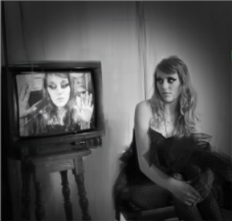
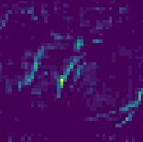
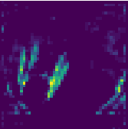
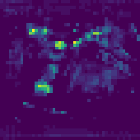
Fast Region Proposal Convolutional Neural Network - FRCNN
RCNN → SPPNet → FRCNN
~ 2 K
Proposals
3 Part → 1 Part Training
Region Proposals
Stage 1
Stage 2
SS / EB
S
P
P
1L
7x7
ROI
Fc
Fc
Fine Tuning on Region Proposals using log loss [SOFTMAX]
(Training Only)
MODEL
VGG 16
C + 1 Class
Fc1
ROI
Pooling
Total Loss
Feature Map
Fc
Only one level SPP with 7x7 grid named as ROI pooling layer.
Using Sigmoid for both training and testing and remove SVM linear classifier makes more sense with no performance drop.
Using Smooth L1 Loss and Combining Classification and Reg Loss.
Classification and Localization Model
Bbox Regression
Smooth L1 Loss

Slide 4
FRCNN - Drawbacks
Hardcoded Region Proposal Network like Selective Search and Edge Boxes
No learnable RPN
Multi Stage Network
[ RPN → CNN ]
Inference time of detection is still not fast enough to use in various use cases.
2.3 sec per image (Including region proposal execution).
Reason of slow inference
SS – 2 sec / image in CPU (classical implementation)
EB – 0.2 sec / image but region proposal quality is bad.
Quick Solution
Create optimal algo of SS which can take advantage of GPU ?
But still non learnable
Create new RPN which is learnable and share compute resources with classification and localization CNN ?

Slide 5
Faster RCNN – Region Proposal Network
Constrain of RPN :
Equivalent or better than SS
Region proposal Quality should be better or equivalent to SS.
Less number of FP ROI
Region Proposal per image generating speed should be faster.
Faster than 2.3 s/image
Should have ≤ 2000 proposals per image.
Otherwise take more time than SS in classification and localisation Network.
Should be learnable.
Not hardcoded algo like SS or Edge Boxes
Overlapping Region of Interest (ROI) with different aspect ratios and different sizes, similar to SS.

Slide 6
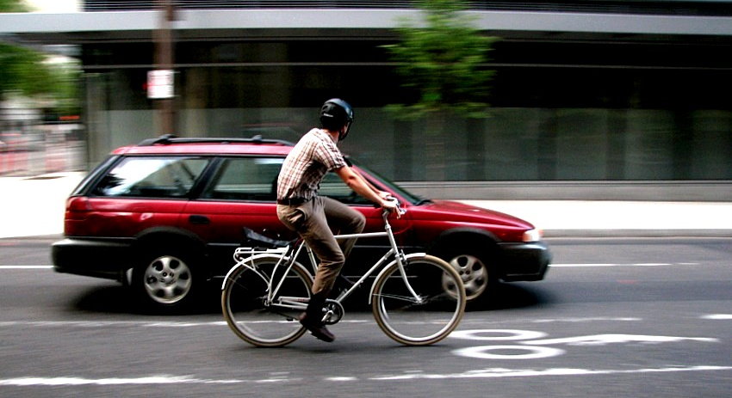
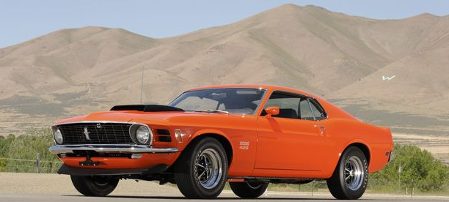

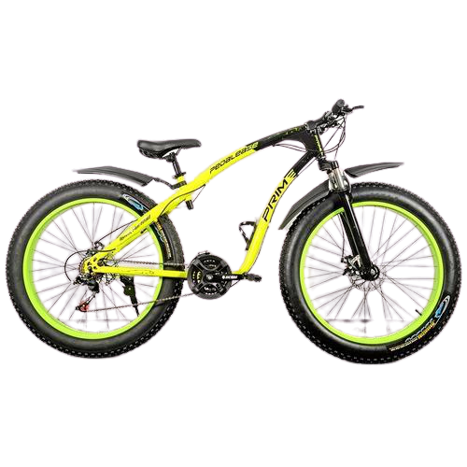
Faster RCNN – Region Proposal Network
Overlapping ROIs
Overlapping ROIs

Slide 7
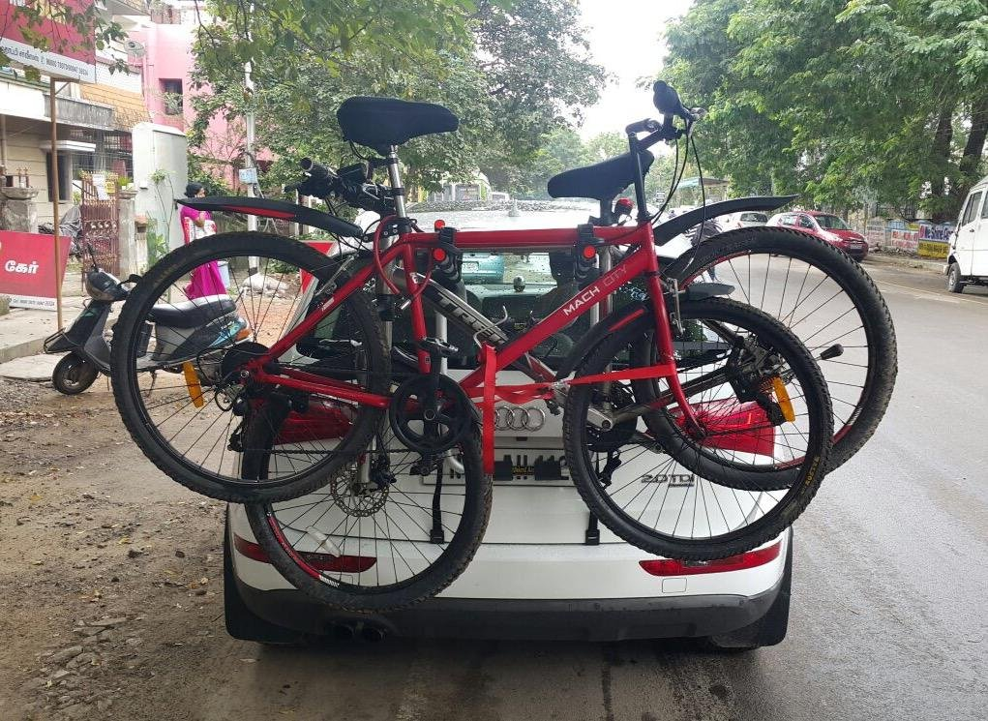
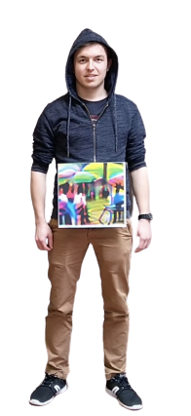
Scale
9 Anchor Box Concept
1:1
1:1
1:1
.
Aspect Ratio
2:1
2:1
2:1
General Properties of Objects →
Criteria of replacing SS or Edge boxes.
Overlapping Region of Interest (ROI) with different aspect ratios and different size
1:2
1:2
1:2

Slide 8
Scale
9 Anchor Box Concept
1:1
1:1
1:1
.
Aspect Ratio
2:1
2:1
2:1
General Properties of Objects →
Criteria of replacing SS or Edge boxes.
Overlapping Region of Interest (ROI) with different aspect ratios and different size
At any single point in image there could be up to 9 objects having same centroid/anchor point.
1:2
1:2
1:2

Slide 9
Faster RCNN – Region Proposal Network
Replace RPN which fulfill all the criteria
~ 2 K
Proposals
3 Part → 1 Part Training
Region Proposals
Stage 1
Stage 2
SS / EB
S
P
P
1L
7x7
ROI
Fc
Fc
Fine Tuning on Region Proposals using log loss [SOFTMAX]
(Training Only)
MODEL
VGG 16
C + 1 Class
Fc1
ROI
Pooling
Total Loss
Feature Map
Fc
Classification and Localization Model
Bbox Regression
Smooth L1 Loss

Slide 10

Faster RCNN – Region Proposal Network
Replace RPN which fulfill all the criteria
~ 2 K
Proposals
Region Proposals
SS / EB
Region Proposals
Input
Classification and Localization Model

Slide 11
Faster RCNN – Region Proposal Network
Image pyramid and Feature pyramid
Replace RPN which fulfill all the criteria
Idea 1
3 different Aspect Ratio Kernel / filter
1 : 1
NMS - FG
CNN
Bbox Reg
1 : 2
3 Scale Image Pyramid
Region Proposals
FG / BG
Classifier
Input
2 : 1
Although RPN would become learnable but would be a lot slower because of image pyramid and feature pyramid.
Classification and Localization Model

Slide 12
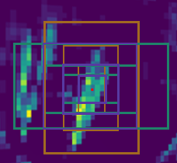
Faster RCNN – Region Proposal Network
Multi scale Multi Aspect Ratio Feature pyramid
Replace RPN which fulfill all the criteria
Idea 2
3 different scale Kernel
3 different Aspect Ratio Kernel
_
1 : 1
NMS - FG
CNN
Bbox Reg
_ _
1 : 2
_ _
Region Proposals
_ _
_ _
2 : 1
FG / BG
Classifier
Input
Classification and Localization Model

Slide 13
Faster RCNN – Region Proposal Network
Multi scale Multi Aspect Ratio Feature pyramid
3 different scale Kernel
3 different Aspect Ratio Kernel
Input
_
Sub Sampling Ratio = 16
1 : 1
_ _
CNN
1 : 2
_ _
Alex NET
600 x 800
38 x 50 x depth
2 : 1
For Each pixel in feature map there would be 9 kernels to convolve.
Total number of possible candidate/proposal processing : 38 x 50 x 9 ≈ 17, 000
Too much possible proposal to process. And back propagation is non-trivial.

Slide 14
Faster RCNN – Region Proposal Network
Multi scale Multi Aspect Ratio Feature pyramid
Replace RPN which fulfill all the criteria
Idea 2
9 Kernels
3 different scale Kernel
3 different Aspect Ratio Kernel
_
1 : 1
NMS - FG
CNN
Bbox Reg
_ _
1 : 2
_ _
Region Proposals
_ _
_ _
2 : 1
FG / BG
Classifier
Input
For Each pixel in feature map there would be 9 kernels to convolve.
Total number of possible candidate/proposal processing : 38 x 50 x 9 ≈ 17, 000
Too much possible proposal to process. And back propagation is non-trivial.
Classification and Localization Model

Slide 15
Faster RCNN – Region Proposal Network
9 - Fixed Anchor/Reference Boxes
Replace RPN which fulfill all the criteria
Idea 3
To understand this Idea first we need to understand the difference between Absolute Bbox training v/s Relative Bbox training.
Region Proposals
Input
Classification and Localization Model

Slide 16
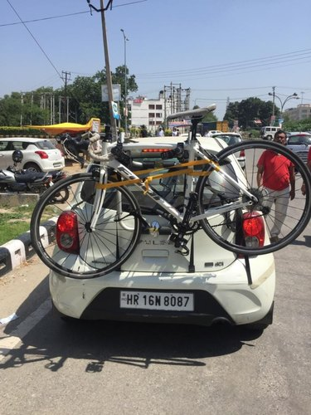
Faster RCNN – Region Proposal Network
Absolute Bbox training v/s Relative Bbox training
Input
Absolute Bbox training
Bbox Output
CNN
Input
CNN
Bbox Output
x_{i ,} y_{i ,} h_{i ,} w_{i}
Absolute Bbox Prediction

Slide 17
Faster RCNN – Region Proposal Network
Absolute Bbox training v/s Relative Bbox training
Input
Absolute Bbox training
Bbox Output
.
CNN
Able to capture only dominating feature objects within the window and no overlapping objects.
Ex : Overfeat bases localization network.
Input
CNN
Bbox Output
x_{i ,} y_{i ,} h_{i ,} w_{i}
Absolute Bbox Prediction

Slide 18

Faster RCNN – Region Proposal Network
Relative Bbox training
Ground Truth
Region Proposal
Reference Box
Predicted Bbox
.
.
.
Person
In the case of RCNN, reference box was given by SS
Predicted Bbox

Slide 19
Faster RCNN – Region Proposal Network
Relative Bbox training
.
Target
Offset
.
Predicted Offset
Ground Truth
Region Proposal
.
Predicted Bbox
Loss

Slide 20
Faster RCNN – Region Proposal Network
Relative Bbox training
.
d_{h}
F C 1
Ground Truth
d_{w}
Bbox Regression
.
Predicted Bbox
dx_{i ,} dy_{i ,} dh_{i ,} dw_{i}
F C 1
L₂ Loss Minimization
d_{y}
Bbox Regression
dx_{i ,} dy_{i ,} dh_{i ,} dw_{i}
d_{x}
^
L =
( x_{i} + dx_{i} - x_{i} ) ²
^ ^ ^ ^
+
x_{i ,} y_{i ,} h_{i ,} w_{i}
^
( y_{i} + dy_{i} - y_{i} ) ²
+
^
( h + dh_{i} - h_{i} ) ²
Loss
+
^
( h+ dw_{i} - h_{i} ) ²

Slide 21
Faster RCNN – Region Proposal Network
Absolute Bbox training v/s Relative Bbox training
Input
Relative Bbox training
Bbox Output
References Boxes
CNN
Able to capture overlapping objects.
Predicts deltas w.r.t reference boxes.
Ex : SS reference Boxes
Input
CNN
Bbox Output
dx_{i ,} dy_{i ,} dh_{i ,} dw_{i}
Relative delta Bbox Prediction

Slide 22
Faster RCNN – Region Proposal Network
Absolute Bbox training v/s Relative Bbox training
Absolute Bbox training
Relative Bbox training
Input
Bbox Output
Input
Bbox Output
CNN
CNN
x_{i ,} y_{i ,} h_{i ,} w_{i}
dx_{i ,} dy_{i ,} dh_{i ,} dw_{i}
Able to capture only dominating feature objects within the window and no overlapping objects.
Ex : Overfeat bases localization network.
Able to capture overlapping objects.
Predicts deltas w.r.t reference boxes.
Ex : SS reference Boxes
Q. How to generate Relative Bbox in RPN ?

Slide 23
Q. How to use Relative Bbox training for RPN ?
Scale
9 Anchor Box Concept
1:1
1:1
1:1
.
Aspect Ratio
2:1
2:1
2:1
General Properties of Objects →
At any single point in image there could be up to 9 objects having same centroid/anchor point.
Criteria of replacing SS or Edge boxes.
Overlapping Region of Interest (ROI) with different aspect ratios and different size
1:2
1:2
1:2

Slide 24
Faster RCNN – Region Proposal Network
9 - Fixed Anchor/Reference Boxes
Idea 3
CNN
9 - Fixed Anchor/Reference Boxes
_ _
_ _

Slide 25
Faster RCNN – Region Proposal Network
9 - Fixed Anchor/Reference Boxes
Idea 3
dx_{i}
dy_{i}
dh_{i}
dw_{i}
CNN
Bbox Reg
9 - Fixed Anchor/Reference Boxes
_ _
_ _
FG / BG
Classifier
For each reference/anchor train FG/BG classifier and apply NMS on FG class to get top k region proposal.
NMS (IOU 0.7)
FG

Slide 26
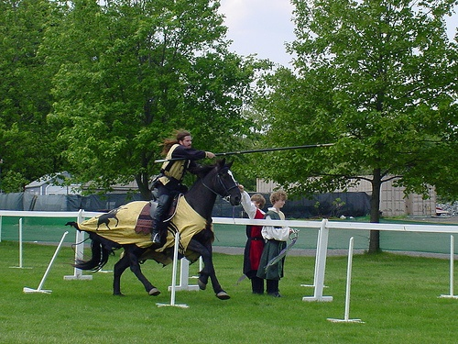
Faster RCNN – Region Proposal Network
Bbox Reg
.
Idea 1
Idea 2
Idea 3
Using only Fixed size reference boxes.
No multiple filters to learn.
Able to achieve criteria the to replace SS
Different schemes for addressing multiple scales and sizes.
(a) Pyramids of images and feature maps are built, and the classifier is run at all scales.
(b) Pyramids of filters with multiple scales/sizes are run on the feature map.
(c) We use pyramids of reference boxes in the regression functions

Slide 27
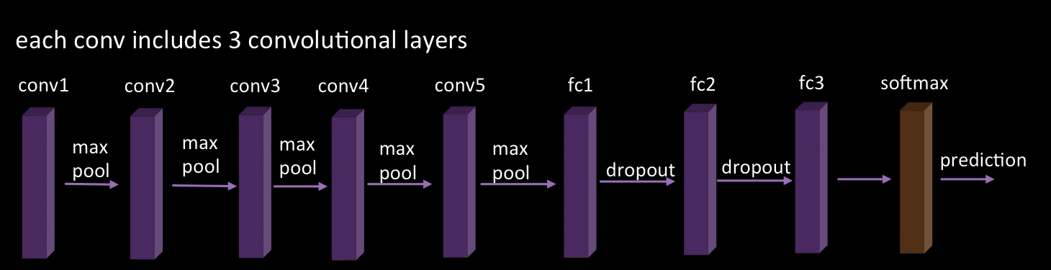
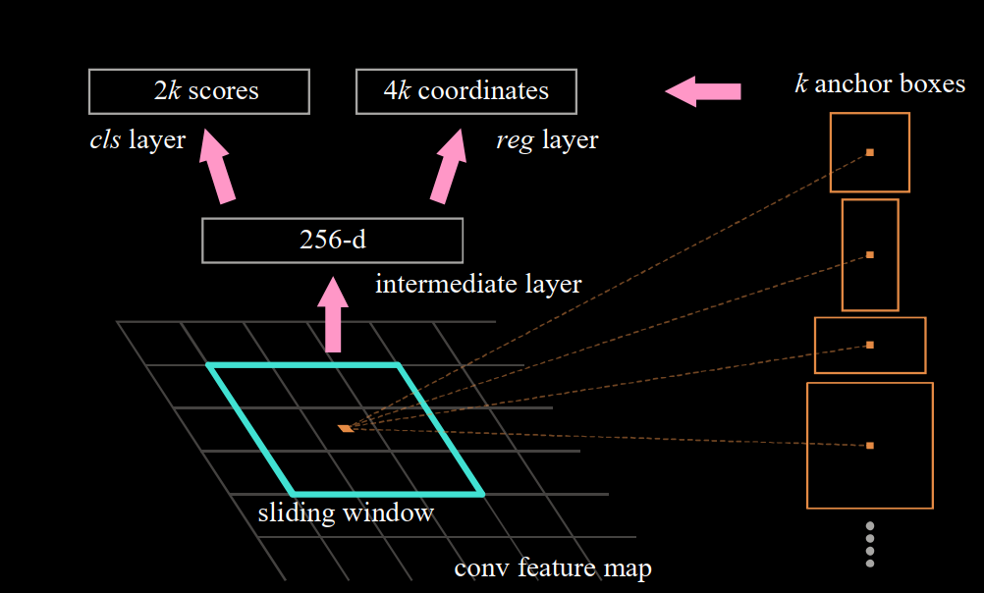
Faster RCNN – Region Proposal Network - Understanding
Pseudo VGG 16
2 X 9 anchor box
4 Bbox X 9 anchor box
conv1
conv2
Each conv includes 3 convolution layer
conv3
conv4
Conv5_1
Conv5_2
Conv5_3
Feature Map
38 x 50 x depth
FC1
FC2
FC3
Replace conv5_3 with
RPN 3x3 convolution filter
SoftMax

Slide 28
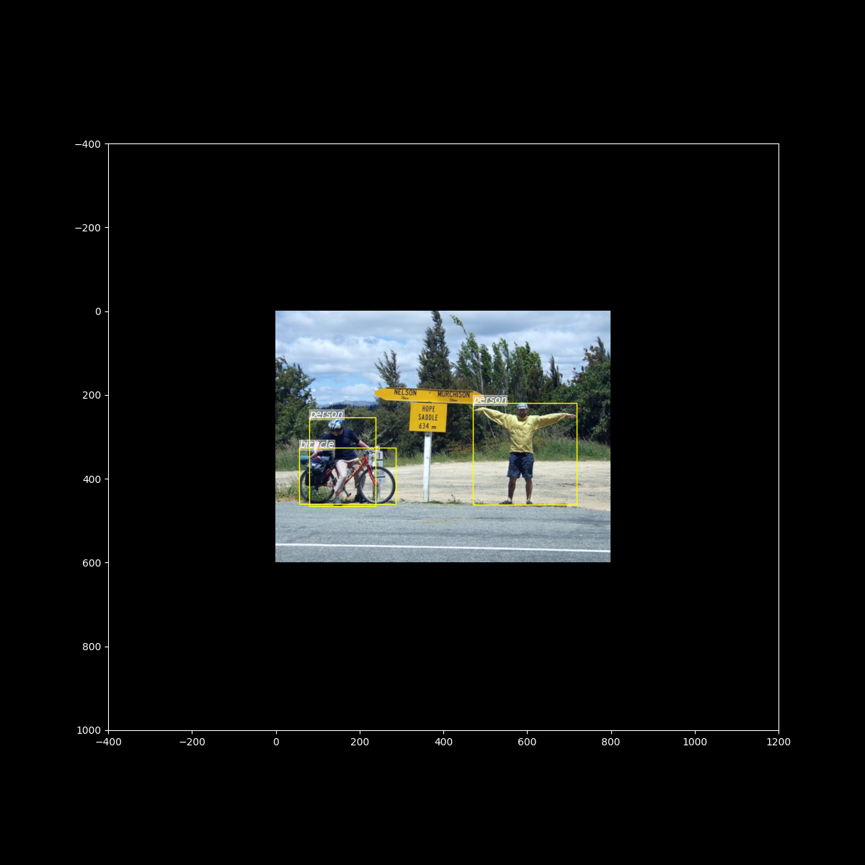
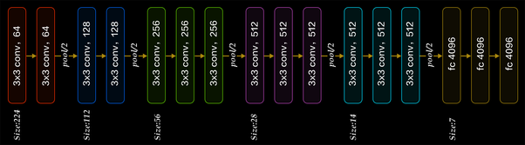
Faster RCNN – Region Proposal Network - Understanding

Slide 29
9 - Fixed Anchor/Reference Boxes
_ _
_ _

Slide 31
.

Slide 32
Faster RCNN – Region Proposal Network
9 - Fixed Anchor/Reference Boxes
Replace RPN which fulfill all the criteria
Idea 3
To understand this Idea first we need to understand the difference between Absolute Bbox training v/s Relative Bbox training.
Region Proposals
Input
Classification and Localization Model

Slide 34
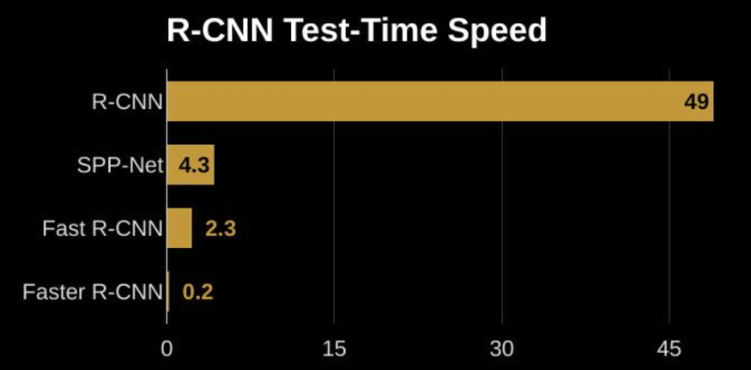

Slide 35
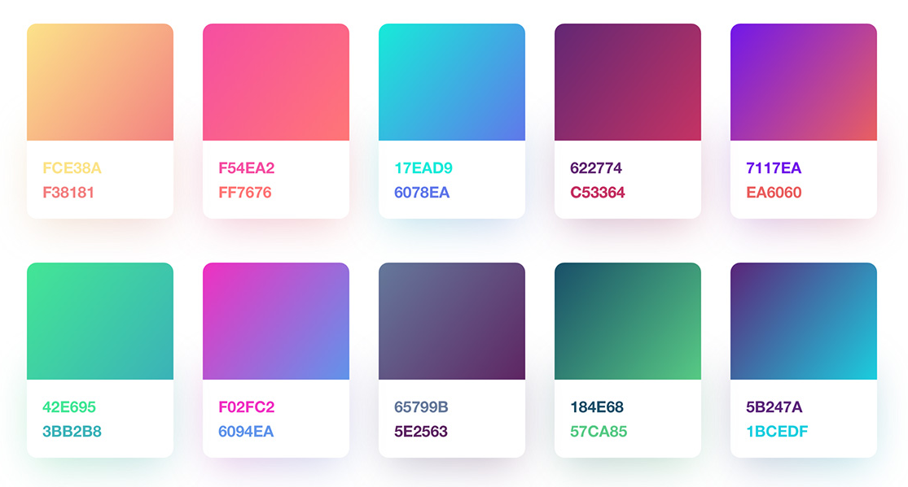
Hello
Hello
Hello
Hello
Hello
Hello
Hello
Hello
Hello
Hello
Hello
Hello

